Slide 1
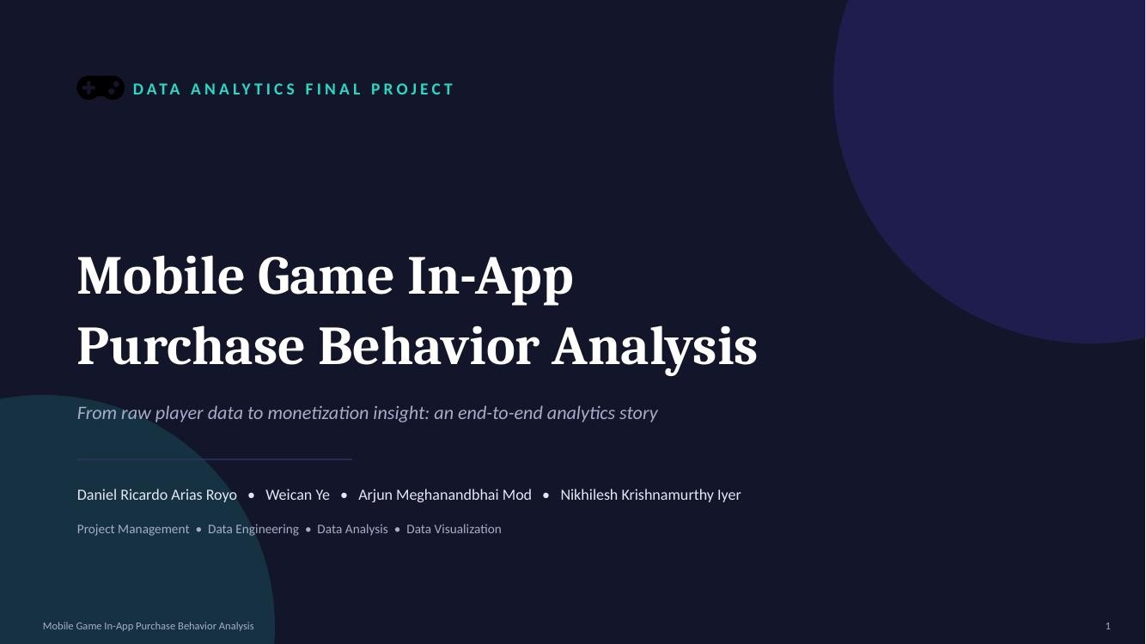

Slide 2



The Business of Mobile Gaming
PROJECT BACKGROUND
Explosive Industry Growth
What Are In-App Purchases?
Why Purchasing Behavior Matters
Mobile gaming is one of the fastest-growing digital entertainment sectors, projected to reach $256.19 billion by 2030.
ln·app purchases (IAPs) let players buy virtual goods, currency, or content inside a game - the core monetization engine for free-to-play titles.
Understanding who buys, why, and how much drives smarter monetization design, targeted offers, and stronger player retention strategies.
Mobile Game In-App Purch.ase Behavior Analysis
2

Slide 3
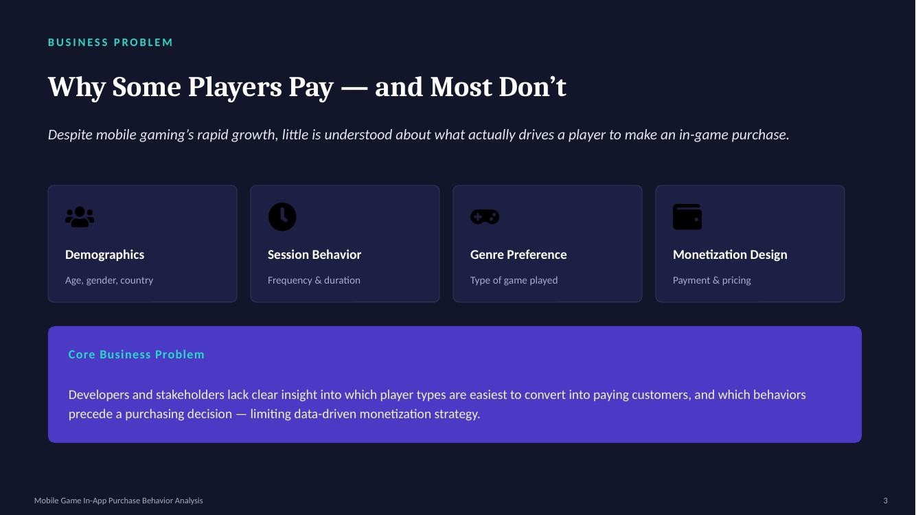

Slide 4
Objective & Research Questions
PROJECT OBJECTIVE
0 Which player demographics are most likely to spend money?
•
How does player engagement relate to purchasing behavior?
•
Which payment methods are associated with the highest spending?
•
What spending patterns exist across player segments (Minnows, Dolphins, Whales)?
•
Which player profile represents the highest-value customer?
Mobile Game In-App Purch.ase Behavior Analysis
•

Slide 5




Dataset Overview
THE DATA
Player Profile
3,024
Player records
(players_cleaned)
18
Player attributes
collected per player
age, gender, country
Device Info
device (AndroidI iOS)
2,887
Purchase transactions
(purchase_cleaned)
10
Purchase attributes
per transaction
Engagement Metrics
session_count. avg_session_length, total_play_mins. game_genre
Source: Kaggle mobile game player & purchase dataset, structured in Post.greSQL and exported for analysis.
Purchase Information
in_app_purchase_amount, spending_segment, tirst_purchase_days_after_install
Monetization Detail
payment_method.last_purchase_date, is_purchaser
Mobile Game In-App Purch.ase Behavior Analysis

Slide 6
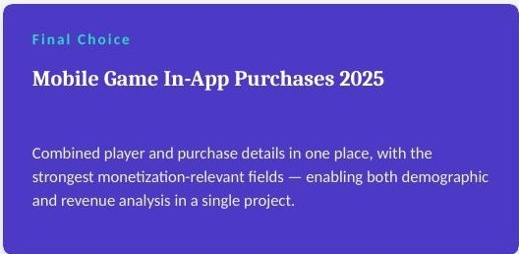
Dataset Selection
DATA FOUNDATION
Dataset Considered
Strengths
Decision
Predict Online Gaming Behavior
-40,000 records; clean structure
Selected at initial stage
Mobile Game User Data Analysis
Strong behavioral focus and purchasing patterns
Not selected as primary source
Mobile Game In-App Purchases 2025
-3,000 records; richer purchase & spend fields with player details combined
Selected after pre-processing (final dataset)
Selection Criteria
e Data quality & completeness
e e e e
Business relevance to monetization
Availability of purchase-related variables
Analytical & statistical potential
Visualization I dashboard potential
Mobile Game In-App Purch.ase Behavior Analysis
6

Slide 7
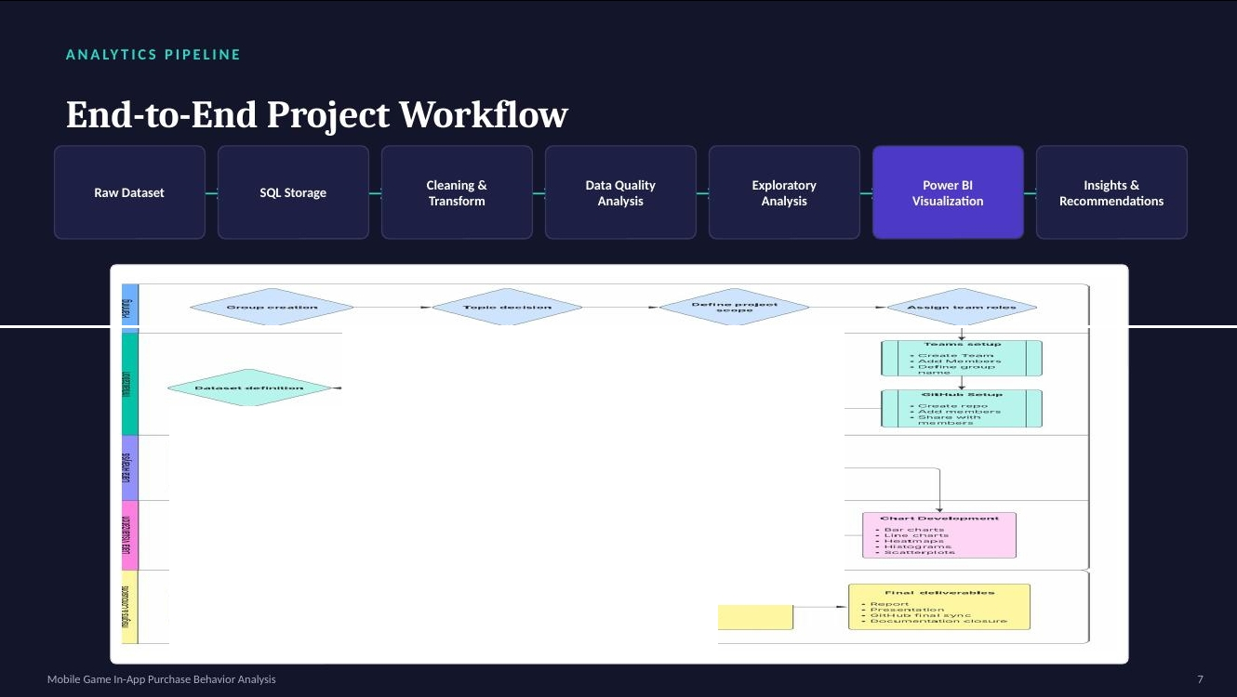
^{r}l ^{o-}....,........-.. ^{I} r -.- ..·...-0·>·'..·••·-]
-{
.:: ::::::::. ::-:. }
[ n••·• • l
t._·:'"-'•' .,,..,·_._ I
[ l
, ...... .
-.........' ........^{-......}
'
°
l
l
j -l.......u-................. / ...... c:o... c.1....-
r G
....·...·. ·......
o.:...-• ..•u•..
................
-.. ................._..
- - .,...............................
. ......... .........
...., ..... ,.......a....... -.<o ...............
• I -..,,•lo,,,..,.... ,.,,.,;..u,,...
J
'.""""......
· A
• V•"•V "-'- """"'V
- .-..""Q' .............. .
- "T.--.-...-1 ••••u•v ..+•
·-
-
=[ :.- :·I. ..·:"" ..;.....:... :.-:..:..:..:..:..·....-......·::. ·]· . -
•- - .. Cl ....••<=)".,., c,.........,.
<:> .. o••-.U••••o,... _{I}
- .,,,^{-•Cl•'=>'"'-Y}..................,,_ ......^{- c:i}.,. ^{•'Y'•}
•_{• H}f.-_{.0}..".₀. •""•.•. ·-· ._....
-[ J -[
ol '"'-''°-"'"U
I
.......-
- ............
•..,."t ..,..,..._.,.. .._,_..,.
...................
• o-•••o.••.., ••hn
...... .......... Ro
₋- ..............,....,....._{c}......g.. _<.Q...'..,.................,._...j
- .......,
...r..u. -.-.v- .. •-·u­

Slide 8





Data Architecture & Repository Layout
PROJECT STRUCTURE
Code | Data | Analysis | Documentation | Reporting
raw_data.sql | Raw (PostgreSQL) | Dataset_Overview.ipynb | README.md | Power Bl dashboard
seed.sqI | players_deaned.csv | Data_quality.ipynb | lnstruction_Data_Clean.md | Final analysis report
 | purchase_cleaned.csv | Device_Distribution.ipynb | worknow diagram | Presentation
 |  | Engagement_Analysis.ipynb | Ganttchart
Data flows le to right: raw records are cleaned and standardized in SQL, explored across four notebooks, then translated into the Power Bl dashboard and final report.
Mobile Game In-App Purch.ase Behavior Analysis
8

Slide 9
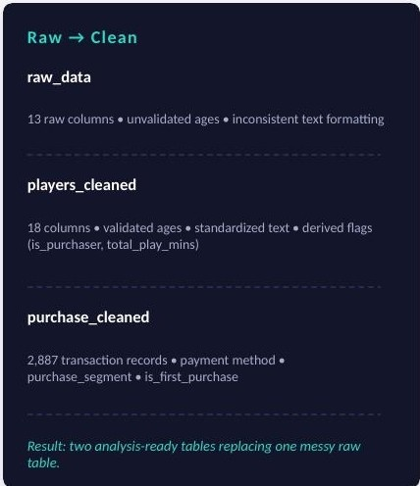





Data Cleaning f1Preparation
DATA ENGINEERING
Age Validation
Ages kept only within 5-80: invalid values set to NULL and flagged (is_outlier_age).
Category Standardization
Gender capitalized & missing valuesset to 'Unknown'; country trimmed & uppercased.
Derived Metrics
total_play_minscomputed as session_count x avg_session_length.
Purchaser Flag
is_purchaser set TRUE when in_app_purchase_amount > O; missing spenddefaulted to 0.
Purchase Segmentation
purchase_cleaned tags each transaction Minnow (S$20}, Dolphin ($20-$500). or Whale (>$500).
Mobile Game In-App Purch.ase Behavior Analysis
9

Slide 10
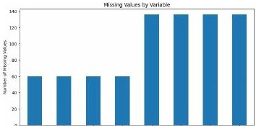
Data Quality Analysis
DATA QUALITY
Variable
Missing Values
age
60
-2°/o
of player records had
missing demographic values
country
60
device
60
•
i
i
l
game_genre
60
i
·
j
}
;:
•'
•
60
records flagged
is_outlier_age=TRUE
tirst_purchase_days_after_instalI
136
•^{i} '
l
payment_method
136
..,rlll
1
last_purchase_date
136
Figure: Datacomptetenessoverview from Doto_quality.ipynb
days_to_tirst_pay
136
Mobile Game In-App Purch.ase Behavior Analysis
10

Slide 11
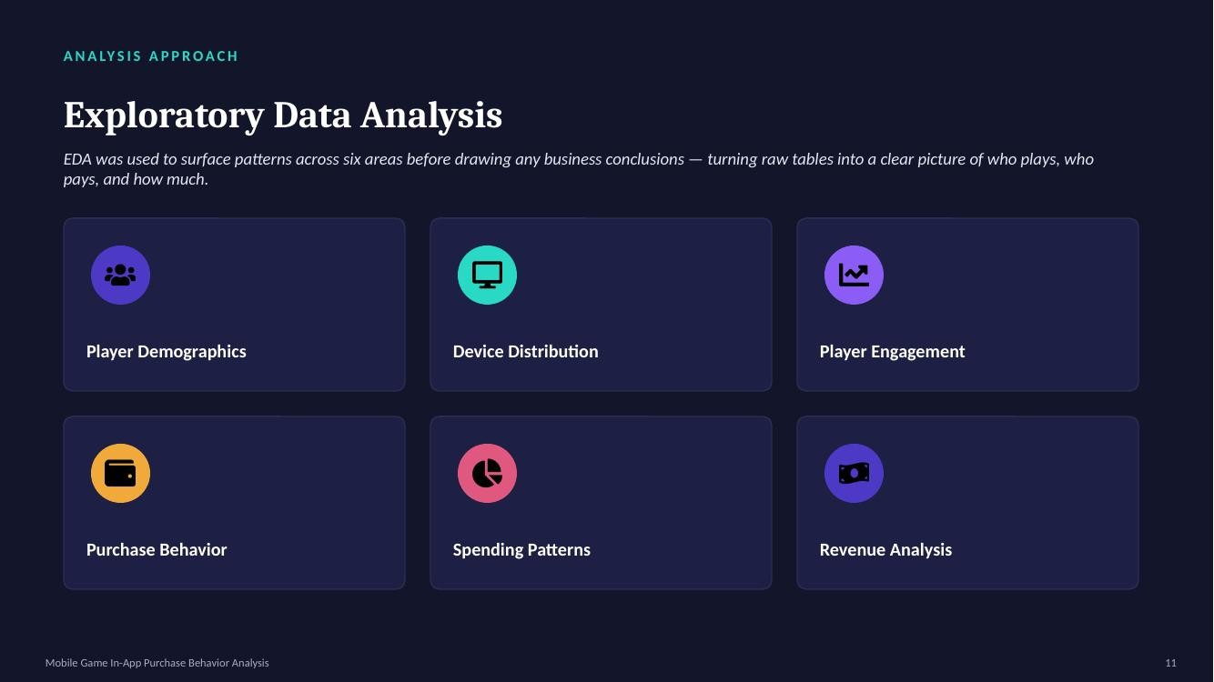

Slide 12
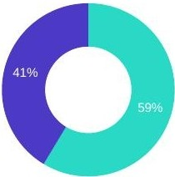
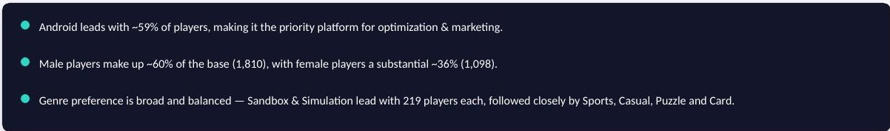
Player & Device Analysis
EDA • PLAYER & DEVICE
Device Distribution (n=2,964)
Top 10 Countries by Player Count
UK | 108
Japan₋ | 112
Italy ₋ | 112
Australia. | 113
Netherlands. | 114
Germany. | 114
Mexico. | 115
Saudi Arabia₋ SWitzerland ₋ India | 116 119
Android • iOS
.
242
.
0
'
'
100
50
150
200
250
300
Mobile Game In-App Purch.ase Behavior Analysis
12

Slide 13
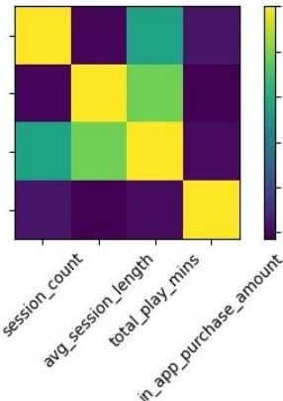
Player Engagement Analysis
EDA • ENGAGEMENT
Correlation Matrix
1.0
session_count
0.8
avg_session_length
total_play_mins in_app_purchase_amount
Session length
Total playtime
0.781
0.6
Session count
Total playtime
0.565
0.4
0.2
0.001
Purchase amount
Total playtime
0.0
Purchase amount
Session count
0.035
Key Insight
Figure; C-0rrelation matrix - enaasen1ent vs. spending (Engogement_Anatysis.ipynbJ
Playtime and session activity are strongly related to each other, but spending
shows almost no relationship with gameplay activity - heavy players are not
necessarily big spenders.
Mobile Game In-App Purch.ase Behavior Analysis
13

Slide 14
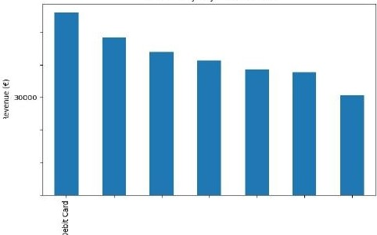

Purchase Behavior f1Monetization
EDA · MONETIZATION
€296,259
Total revenue generated
95.5°/o
Purchaser conversion rate
€102.62
Average transaction value
Revenue by Payment Method
50000
Average Spend by Player Segment(€)
40000
3000
2500
2000
1500
1000
500
2,582
20000
10000
0
1
11
.
>-
11
u
,..
.. ,
0
11
>-
0
i
•
ll'.
"'
.E
,⁰,,
0.
"
234
u
Payment Method
u
₀ 10
Minnow Dolphin
Whale
Figure: Revenue by payrnent method (project analysis report)
Minnows are 84% of players but Whales (2%) drive disproportionate revenue - Debit Card, PayPal. and Gift Card are the top-earning payment methods.
Mobile Game In-App Purchase Behavior Ana1ysis
14

Slide 15
